Slide 1
Quadratic optimization with quantum computing
Presentation 2
Bálint Hantos
Supervisor: Péter Rakyta
Notes:
What I’m going to talk about today is the theoretical background of the properties of bosonic circuits and doing calculations with them.
The reason I chose this project is that quantum computers have the potential to revolutionize computation by making certain types of classical problems solvable.
While no quantum computer is sophisticated enough to do these calculations yet. But a great progress is under way.

Slide 2
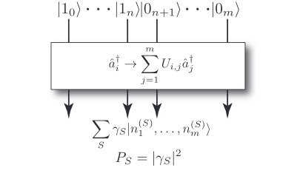
Overview: Boson sampling
Relation to matrix permanents:
A – unitary of the linear optics network
Complex-valued permanent: #P problem
Boson sampling is classically inefficient
Gard, Bryan T., et al. "An introduction to boson-sampling.„ 2016
Notes:
What is a boson sampler and how it works?
Here is what the boson sampler does on a diagram.
On top, there are single photon states and vacuum states, that are propagated through a linear optics network.
It implements a unitary map on the creation operators like this.
Then at the output we’ve got some big superpositions of the multiphoton optical states.
In this notation S represents a configuration of where the photons could arrive.
Gamma represents the amplitude associated with that configuration.
N sub 1 super S is the number of photons in the state 1 in the configuration S.
The output state represent all the possible configurations.
Then we measure the output and we get the S configuration with absolute gamma squared probability.
So the goal is to build up statistics of what P of S looks like.
Then the question is why do we need a quantum computer for that?
One of the key results is that measuring the probability of a given configuration is proportional to a permanent of the A matrix.
The A matrix is a unitary transformation describing the linear optics network and the output configuration.
It is a very hard problem to calculate complex-valued matrix permanents. So boson sampling is classically inefficient to simulate, we need a real quantum device to that.

Slide 3
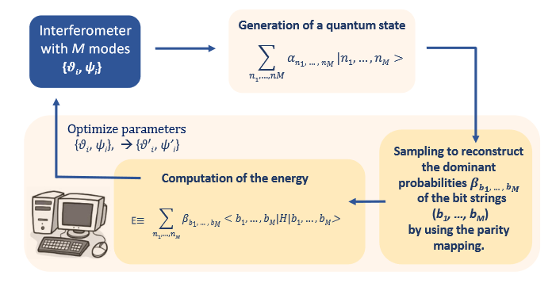
Model overview
Bradler, Kamil, and Hugo Wallner. "Certain properties and applications of shallow bosonic circuits.„ 2021
Notes:
This is the model overview of the variational bosonic solver.
In the first step we generate a quantum state with the M-mode interferometer.
The amplitudes of the quantum states depend on the circuit elements’ angles, thetas and psis.
Then we apply a parity function so that the we map the optical states to a many-qubit hilbert space. Then we have our qubits.
Note: Each qubit state has a some energy associated with it.
So we apply the parity functions and record the amplitudes of the qubits.
Then using these amplitudes and the qubit states we calculate the expected value of the energy – it is the objective function, that we try to minimize.
Then we tweak the psi and theta parameters with gradient descent and do the previous steps again.
The goal is to find the smallest energy and the associated bit string.
So, how can we use this ? We need to formulate our our problem as optimizing the energy by choosing an appropriate Hamiltonian matrix.

Slide 4



Setup
Installed Ubuntu on Docker
Installed necessary dependencies
Built with Conda from Github source

Slide 5
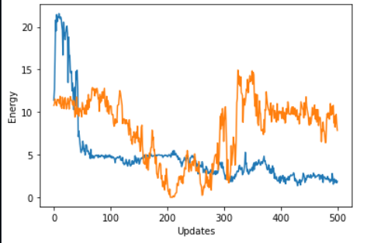
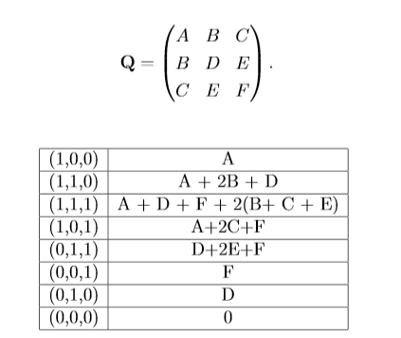
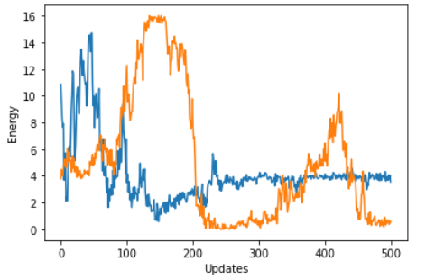
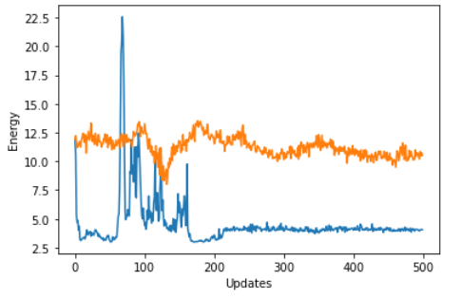
First steps
Degenerate case
General symmetric matrix
General case
Trivial case
Notes:
Left on top Ambigous case
Left on bottom Trivial case

Slide 6
Thank you for your attention

